Slide 1

Department Of Computer Science

Slide 2
Software Requirement Specification Allergy Flares
ARSLAN AMIN
SP21-BCT-005
HALEEMA SAADIA
SP21-BCT-007
Supervisor:
Mr. Tehseen Riaz Abbasi
Department Of Computer Science
Submission Date: (23-11-2022)

Slide 3
Project Category
A-Web Application
K- Artificial Intelligence
C- Smartphone Application

Slide 4
Research Based Project
NO

Slide 5
Introduction
This chapter provides the overview of the project, in this chapter we discussed the vision statement of AI chat bot and its limitations, what we are going to deliver, tool and technologies which we used to build Chatbot and how this project related to our course module.
Additionally, businesses that operate, gather a lot of data, and depend on making quick judgments in real time need to mix AI and intelligent bots. Therefore, a chatbot system will be quite useful in this setting. The ease with which those who dislike chatbots can be connected to actual personnel is one of their best features. The flexibility to switch between assisted and unassisted selling and the choice to engage a human sales assistant when necessary is one of a sales chatbot's most crucial capabilities. Thanks to chatbots, businesses can now provide more to their online clients, frequently for less money. The use of chatbots in many areas of business increases communication rates, customer satisfaction, and workflow.

Slide 6
Purpose
This document's primary goal is to give a thorough description of the application. In order to effectively accomplish this project, all application functionalities will be listed in this document. The project "AI Chatbot" is described in general terms in this paper, together with its functional and nonfunctional requirements, user interfaces, attributes, and use case diagrams. The document is meant for documentation writers, users, and project managers.

Slide 7
Modules
Module 1: Profile management
Module 2: Daily base communication
Module 3: Registered people management
Module 4: Bot training
Module 5: Health care
Module 6: Generals
Module 7:Sentiment Analysis
Module 8:Chatbot analytics
Module 9:Personal assistance
Module 10:Help and support

Slide 8
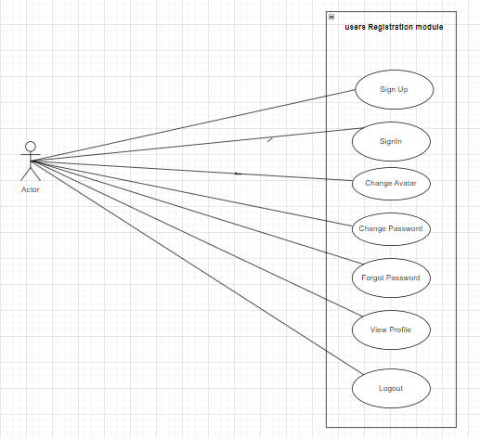
Use Case Diagram

Slide 9
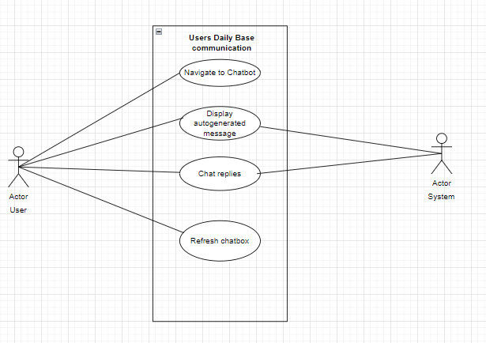
Use Case Diagram

Slide 10
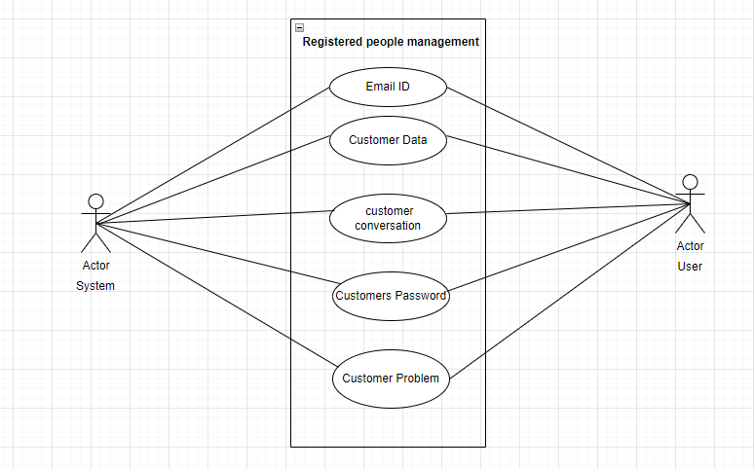
Use Case Diagram

Slide 11
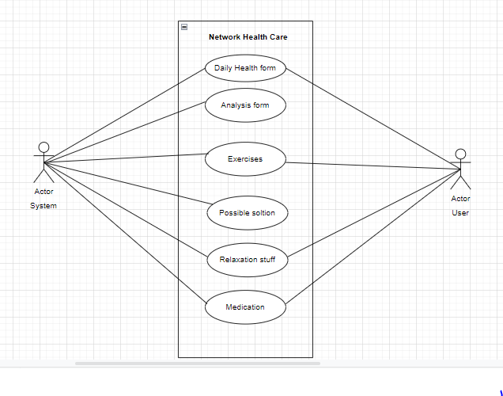
Use Case Diagram

Slide 12
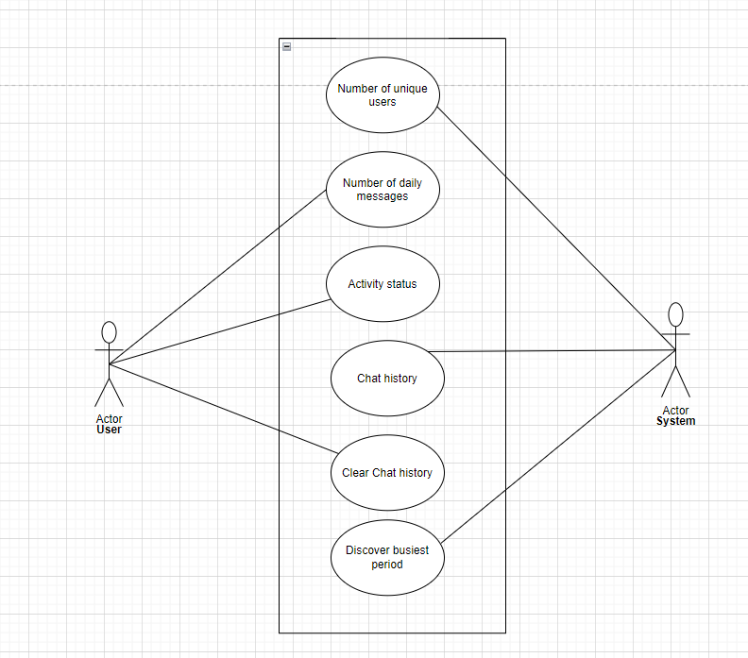
Use Case Diagram

Slide 13
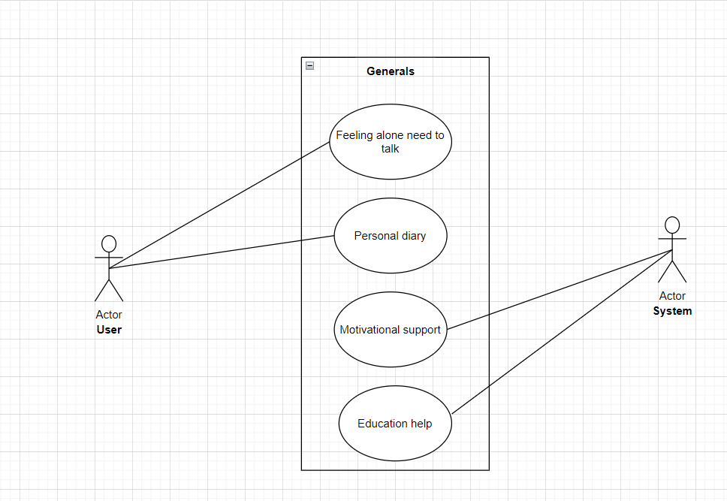
Use Case Diagram

Slide 14
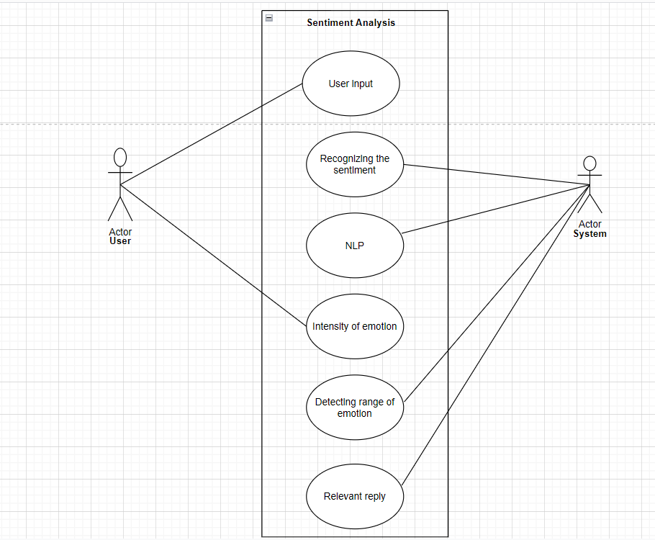
Use Case Diagram

Slide 15
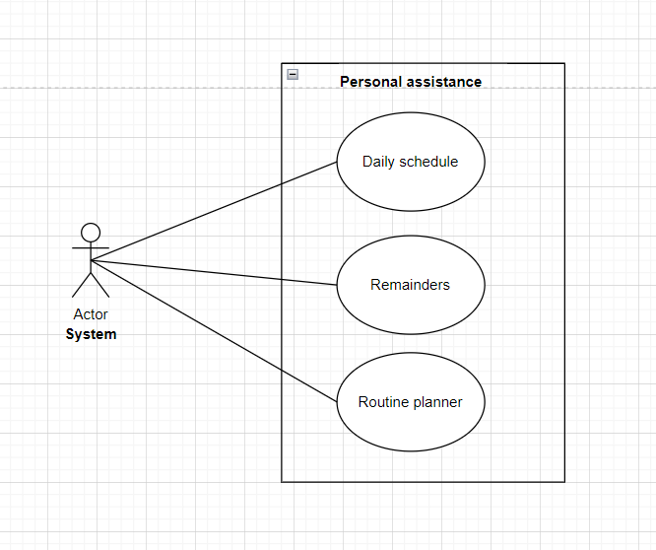
Use Case Diagram

Slide 16
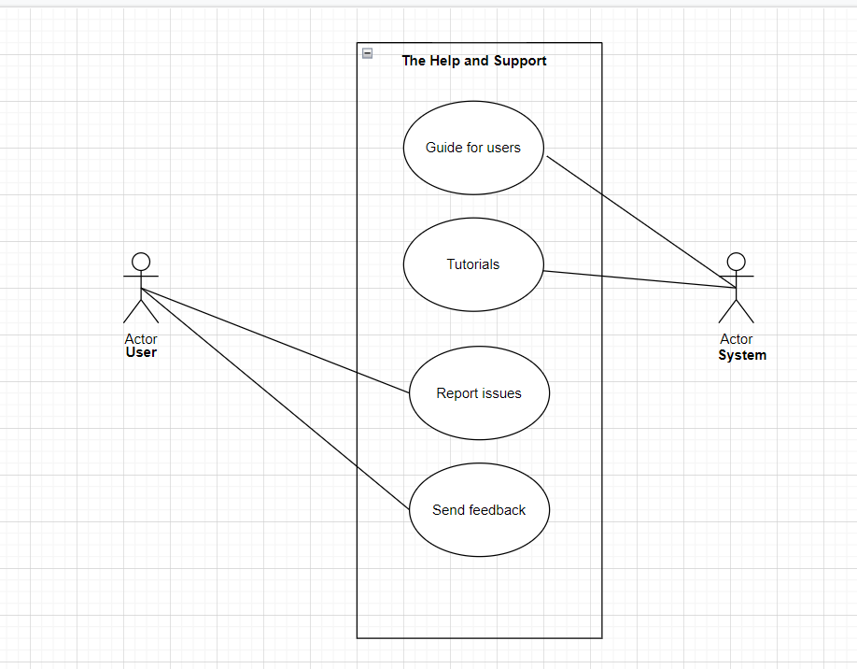
Use Case Diagram

Slide 17
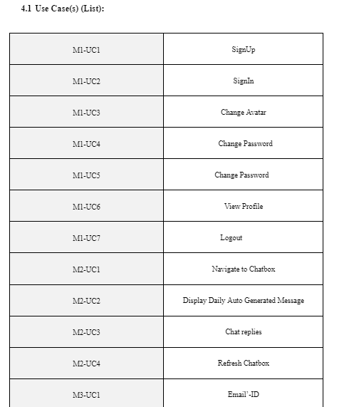
List of Use Cases

Slide 18
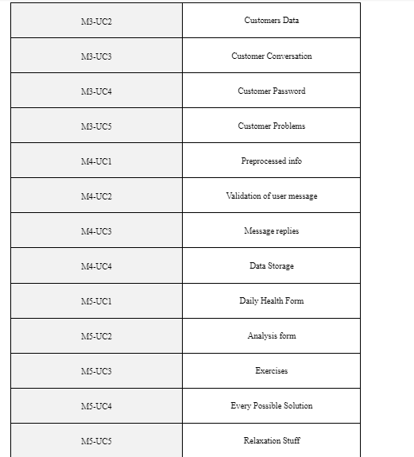
List of Use Cases

Slide 19
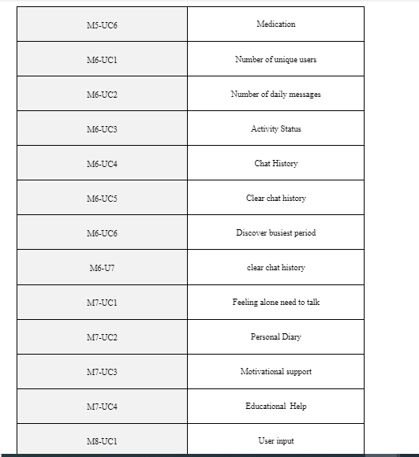
List of Use Cases

Slide 20
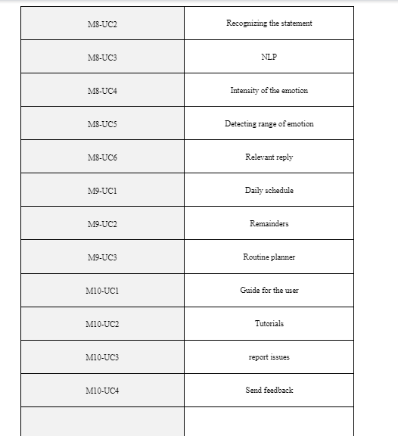
List of Use Cases

Slide 21
Non-Functional Requirement
Reliability
When compared to other applications, this programme is 98% accurate and dependable. If the programme is malfunctioning and down due to some failure, the failure will be replied to in no more than five hours with the goal of quickly resolving the problem.
Approximately two to three defects per thousand lines of code could be present. As soon as they are discovered, these bugs are fixed.
Usability
Practice Period
A typical user can use the app for no more than 10 minutes.
Level of difficulty The application has an intuitive GUI and is simple to use.
.
Performance
Our AI chatbot Xotron has high performance. It effectively talks to the user about daily life things, also keeping a check on the users health. Chatbots performance can be measured by Goal Completion Rate. Conversation Starter Messages. Health updates. Bot intent analytics. Bot Messages. New Users. Total Users. Active Users. Xotron is a very easy to use friendly bot. It saves time and money. We use chatbot analytics, by using chatbot analytics, you can identify the queries your business receives over live chat.
Security
One or more requirements about protection of your system and its data. The measurement can be expressed in a variety of ways (effort, skill level, time, ...) to break into the system. Do not discuss solutions (e.g. passwords) in a requirements document.

Slide 22
Non-Functional Requirement
3. Performance
Response
Average = 2 second. Maximum = 3.15 seconds
Resource Utilization
Memory = 80-120 MB. Ram = 20MB
Capacity
can handle thousands of users at a time
Degradation modes
Application will restart
4. Security
There is little security issue with this application since it’s allergy detector application and user will has his/her own account but it will used as a general-purpose application. There is also option for recovery password method through email and mobile phone number

Slide 23
Conclusion
In this document we have made the use case diagrams of the modules we chose in the previous assignment. Each module must have 7-8 use case diagrams. Then the Functional Requirements of those use cases are made from the tabular form of the modules. Our chatbot gives employees time to focus on more important tasks and prevents customers from waiting to receive responses.

Slide 24
References
1-https://chatbotsmagazine.com/tutorials/home
2-https://www.rocky.ai/diary-app
3-https://pomofocus.io/
4-https://chatbotsmagazine.com/positivity-motivation-and-chatbot-encouragement-af04b3449d98
5-https://dashthis.com/kpi-examples/unique-users/
These the google links of the references that we used.

